Slide 1
Grid-following Voltage Source Converter : modelling under phasor approximation and simulation results on the 4-VSC test system
Thierry Van Cutsem
thierry.h.van.cutsem@gmail.com
https://thierryvancutsem.github.io/home/
March 28, 2024

Slide 2
Motivation and objectives
Power-electronics converters push the phasor approximation to its limit (and beyond…)
There is a need for benchmark systems
with large penetration of converters
small enough to be easily tractable
complex enough to reflect real-life systems
easily implemented in various simulation tools
A 100% power electronics, 4-VSC test system is presented
The embedded EMT models of VSCs were developed, tuned and thoroughly tested by Prof. Xavier Guillaud and his team at Ecole Centrale de Lille, France
this presentation focuses on models under the phasor (or “RMS”) approximation
simulation results in phasor-mode are compared with their EMT counterparts

Slide 3
Motivation and objectives
Models and data of the benchmark are available in open source
This is not a presentation about the “best” design and/or tuning of VSC controls
the generic models in this presentation are generic
they encompass many variants proposed in the literature

Slide 4
Table of contents
Motivation and objectives
Modelling of the grid-following VSC
Examples of simulations in the 4-VSC system
Comparison with EMT simulations

Slide 5
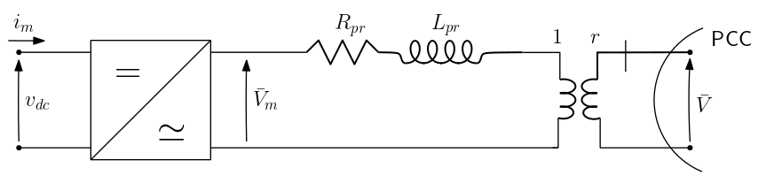
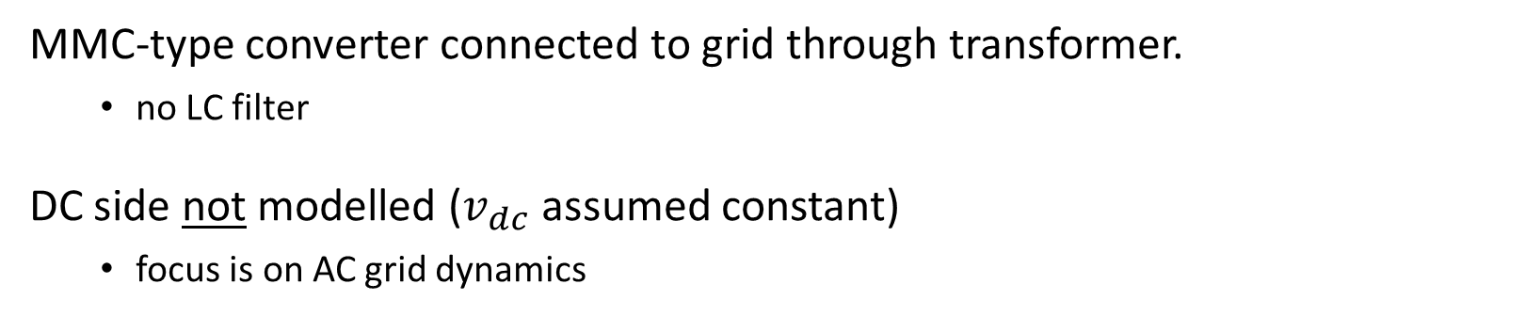
Grid-following VSC model: basic assumptions
MMC-type converter connected to grid through transformer.
no LC filter
DC side not modelled ($v_{dc}$ assumed constant)
focus is on AC grid dynamics

Slide 6
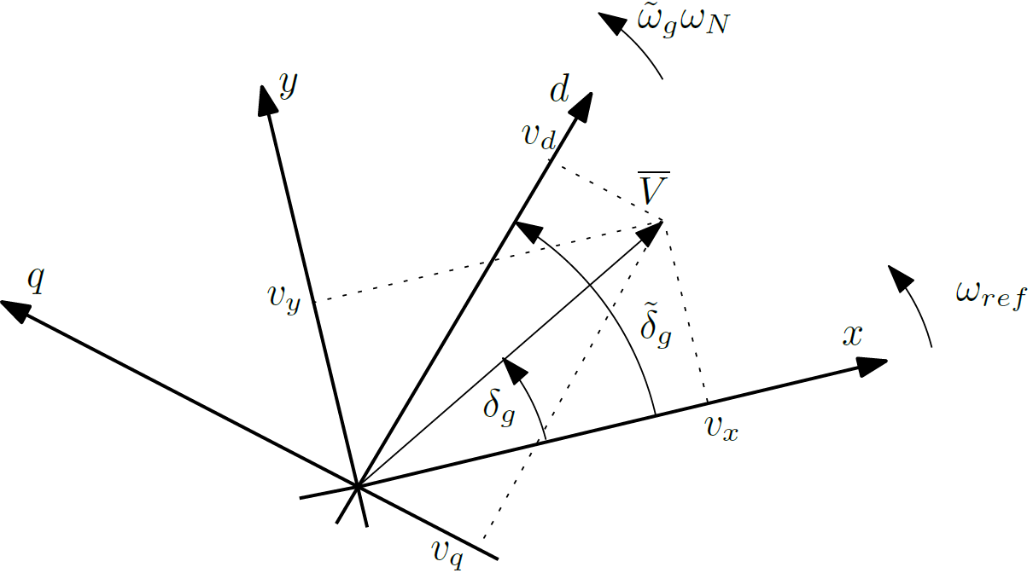
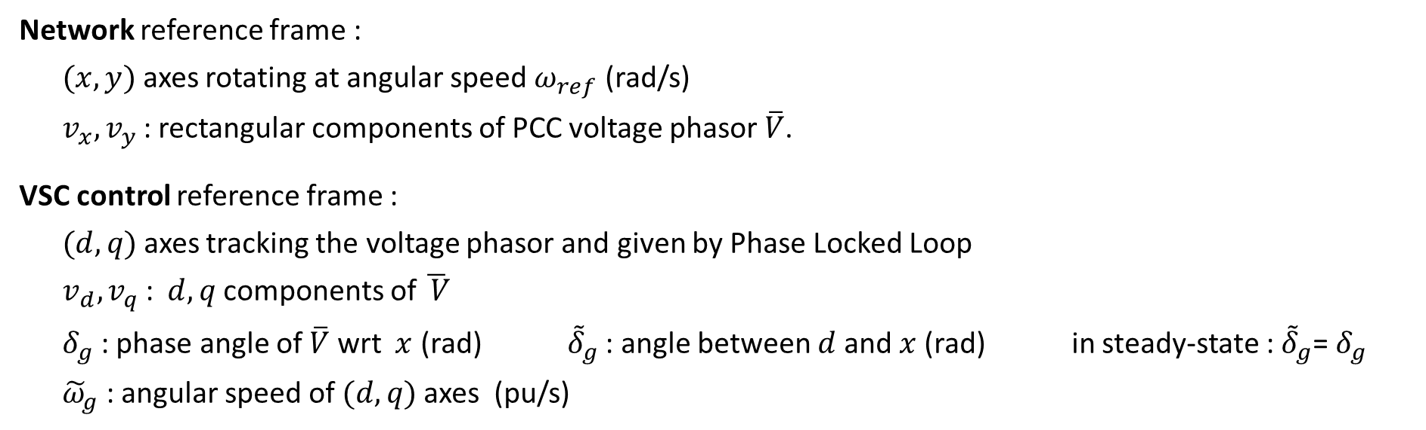
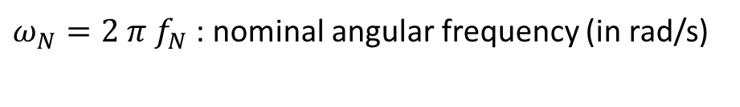
Grid-following VSC model: reference frames
$ω_{N}=2 π f_{N}$ : nominal angular frequency (in rad/s)
Network reference frame :
$(x,y)$axes rotating at angular speed $ω_{ref}$ (rad/s)
$v_{x}, v_{y}$ : rectangular components of PCC voltage phasor $\overline{V}$.
VSC control reference frame :
$(d,q)$axes tracking the voltage phasor and given by Phase Locked Loop
$v_{d}, v_{q}$ : $d,q$components of $\overline{ V}$
$δ_{g}$ : phase angle of $\overline{V}$ wrt $x$ (rad) ${\tilde{δ}}_{g}$ : angle between $d$and $x$(rad) in steady-state : ${\tilde{δ}}_{g}$= $δ_{g}$
${\tilde{ω}}_{g}$ : angular speed of $(d,q)$axes (pu/s)

Slide 7
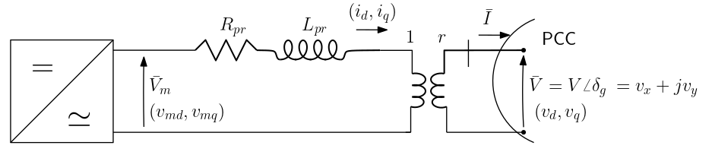
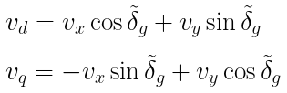
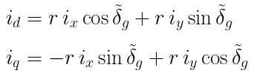
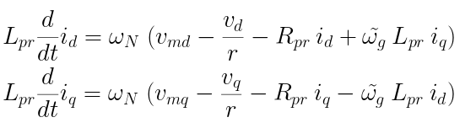
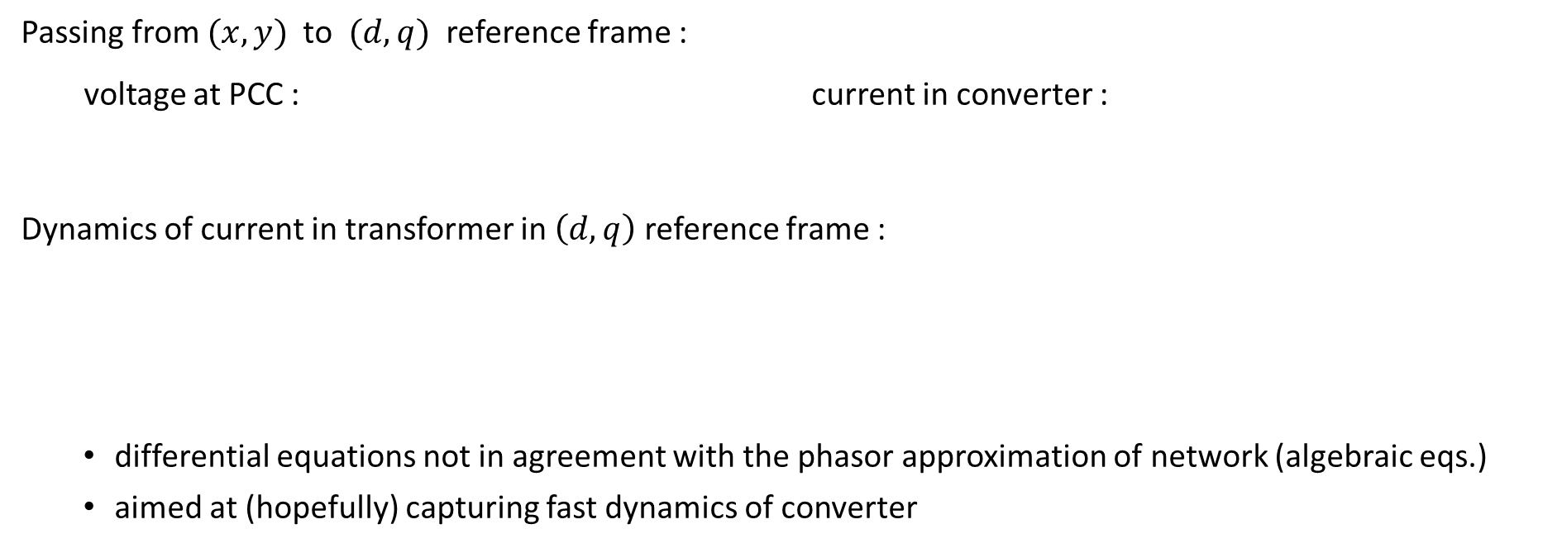
Grid-following VSC model: voltages and currents in transformer
Passing from $(x,y)$ to $(d,q)$ reference frame :
voltage at PCC : current in converter :
Dynamics of current in transformer in $\left(d,q\right)$ reference frame :
differential equations not in agreement with the phasor approximation of network (algebraic eqs.)
aimed at (hopefully) capturing fast dynamics of converter

Slide 8
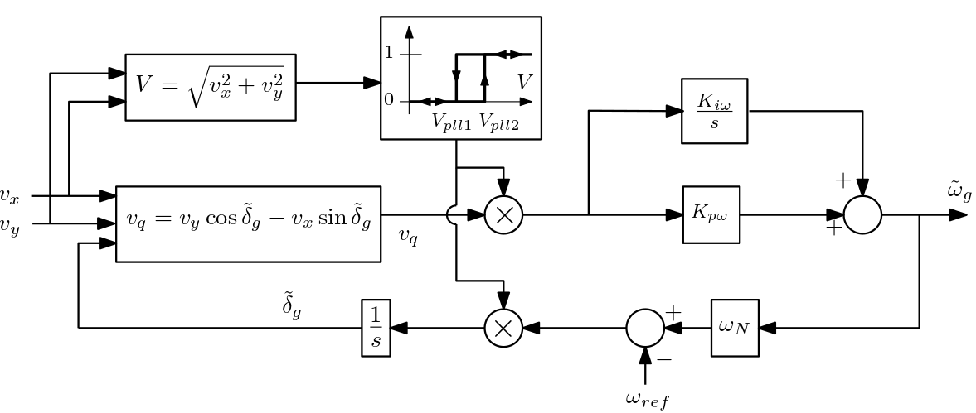


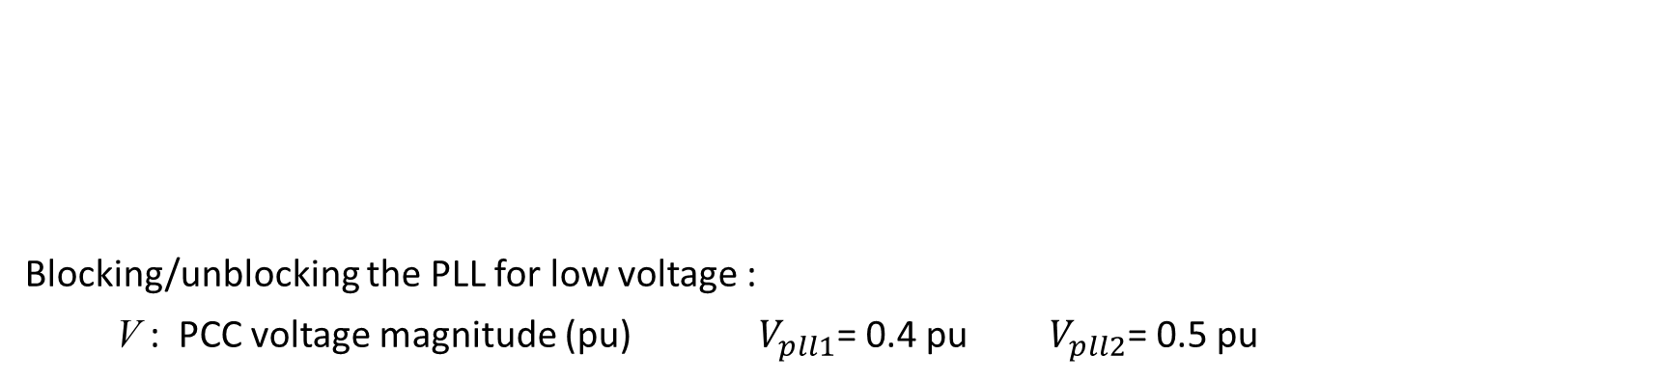
Grid-following VSC model: Phase Locked Loop (PLL)
Blocking/unblocking the PLL for low voltage :
V : PCC voltage magnitude (pu) $V_{pll1}$= 0.4 pu $V_{pll2}$= 0.5 pu
values in per unit on the S_{nom} base (nominal apparent power of converter)

Slide 9
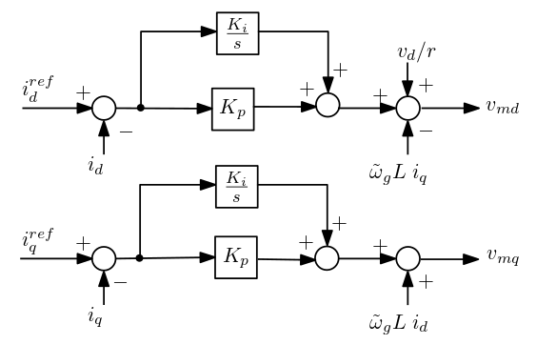
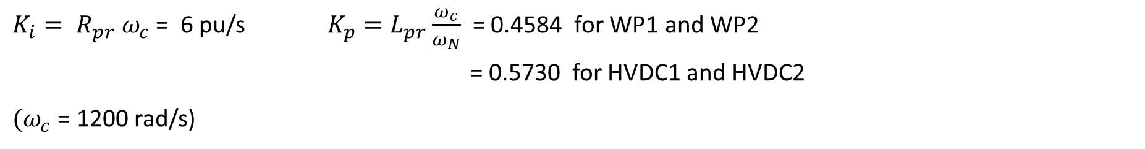
Grid-following VSC model: d-q current control
$K_{i}= R_{pr} ω_{c}$ = 6 pu/s $K_{p}=L_{pr}\frac{ω_{c}}{ω_{N}}$ = 0.4584 for WP1 and WP2
= 0.5730 for HVDC1 and HVDC2
${(ω}_{c}$ = 1200 rad/s)

Slide 10
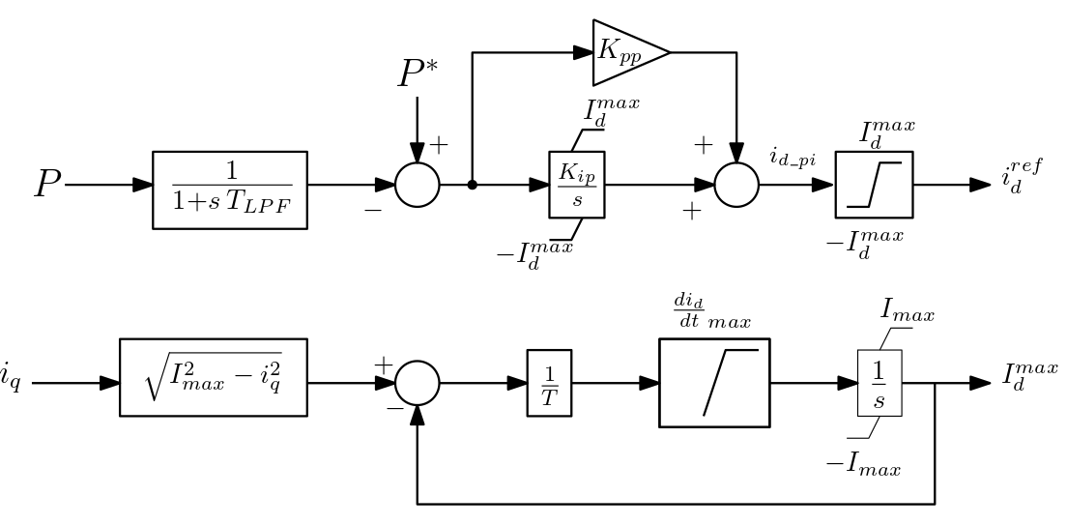
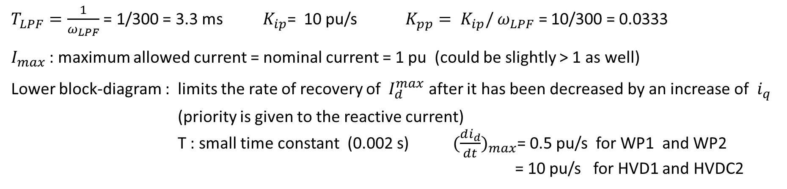
Grid-following VSC model: active power control
$T_{LPF}=\frac{1}{ω_{LPF}}$ = 1/300 = 3.3 ms $K_{ip}$= 10 pu/s $K_{pp}= K_{ip}/$ $ω_{LPF}$ = 10/300 = 0.0333
$I_{max}$ : maximum allowed current = nominal current = 1 pu (could be slightly > 1 as well)
Lower block-diagram : limits the rate of recovery of $I_{d}^{max}$ after it has been decreased by an increase of $i_{q}$
(priority is given to the reactive current)
T : small time constant (0.002 s) ${(\frac{di_{d}}{dt})}_{max}$= 0.5 pu/s for WP1 and WP2
= 10 pu/s for HVD1 and HVDC2

Slide 11
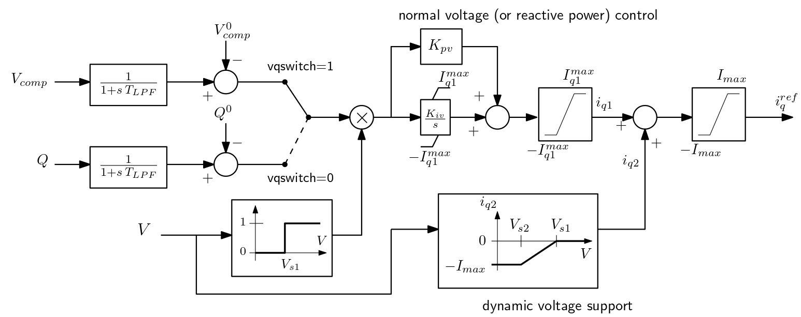

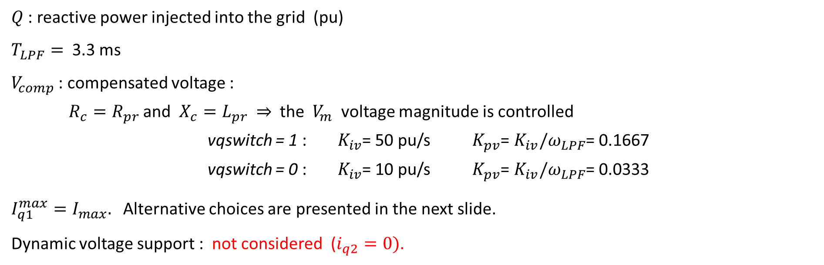
Grid-following VSC model: voltage / reactive power control
$Q$ : reactive power injected into the grid (pu)
$T_{LPF}=$ 3.3 ms
$V_{comp}$ : compensated voltage :
$R_{c}=R_{pr}$ and $X_{c}{=L}_{pr} ⇒$ the $V_{m}$ voltage magnitude is controlled
vqswitch = 1 : $K_{iv}$= 50 pu/s $K_{pv}$= $K_{iv}/ω_{LPF}$= 0.1667
vqswitch = 0 : $K_{iv}$= 10 pu/s $K_{pv}$= $K_{iv}/ω_{LPF}$= 0.0333
$I_{q1}^{max}=I_{max}.$ Alternative choices are presented in the next slide.
Dynamic voltage support : not considered ($i_{q2}=0)$.

Slide 12
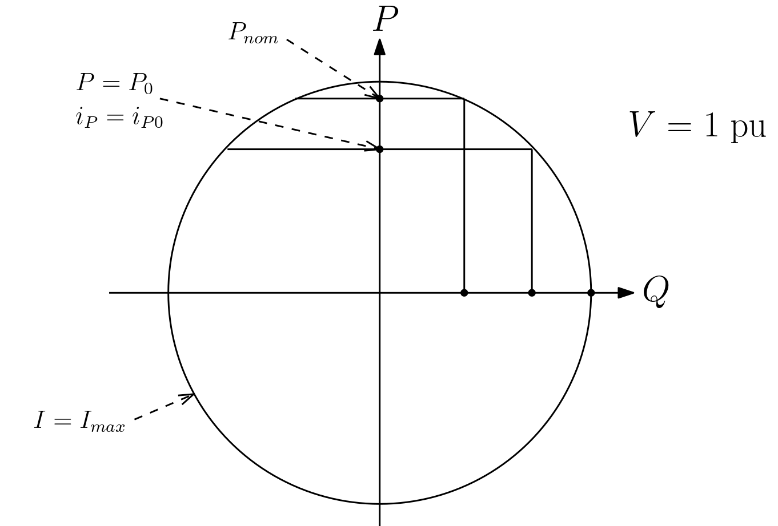
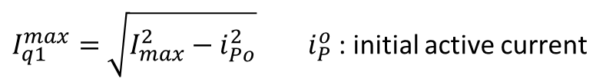

Grid-following VSC model: limit $I_{q1}^{max}$on quadrature current
Examples of values :
All values in per unit
Full current can be used : $I_{q1}^{max}=I_{max}$
$I_{q1}^{max}=$ $\sqrt{I_{max}^{2}−i_{Po}^{2}} i_{P}^{o}$ : initial active current
$\tan{φ_{nom}}$ specified (e.g. 0.3) : $I_{q1}^{max}=\tan{φ_{nom}}{.P}_{nom}$

Slide 13
Table of contents
Motivation and objectives
Modelling of the grid-following VSC
Examples of simulations in the 4-VSC system
glance at simulation tool
large-disturbance simulation
Comparison with EMT simulations

Slide 14
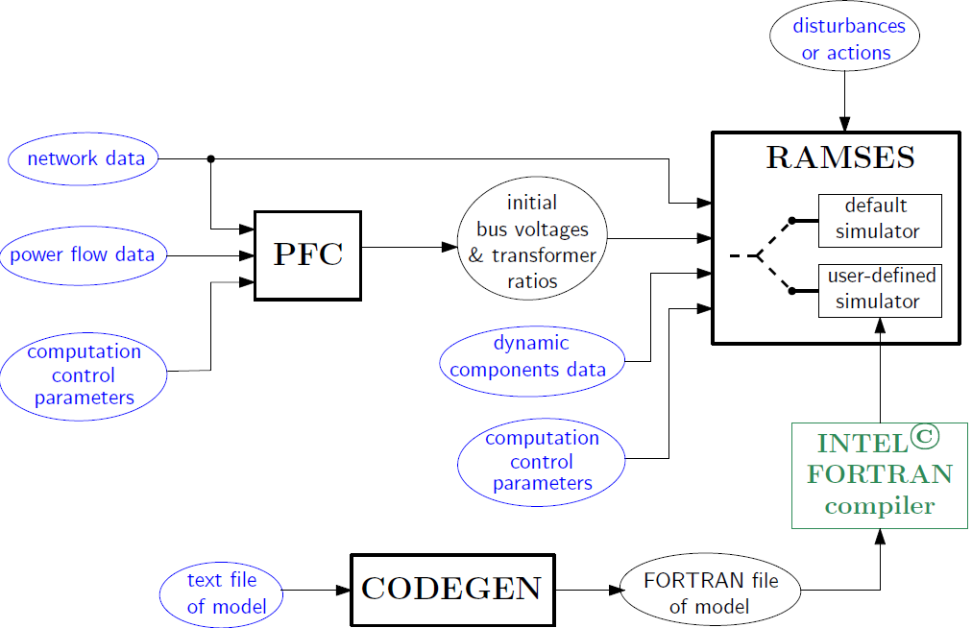
STEPSS (Static and Transient Electric Power Systems Simulation)
Power Flow Computation
RApid Multithreaded Simulation of Electric power System
CODE GENerator : translation
of user-defined models

Slide 15
STEPSS (Static and Transient Electric Power Systems Simulation)
RAMSES
differential/algebraic equations solver developed at the Univ. of Liège by P. Aristidou and T. Van Cutsem
phasor approximation
decomposition (Schur-complement) + localization techniques
parallel processing
CODEGEN
receives user-defined models written according to a simple syntax
translates them into FORTRAN 2003 code, to be compiled and linked to the rest of RAMSES
4 types of models : excitation control of sync. mach. / torque control of sync. mach. / injectors / two-ports
models freely shared by users → open-source simulation software
LICENSE TERMS
STEPSS can be used free of charge for non-commercial/non-profit purposes, in a version limited to 1000 buses and 2 cores.

Slide 16
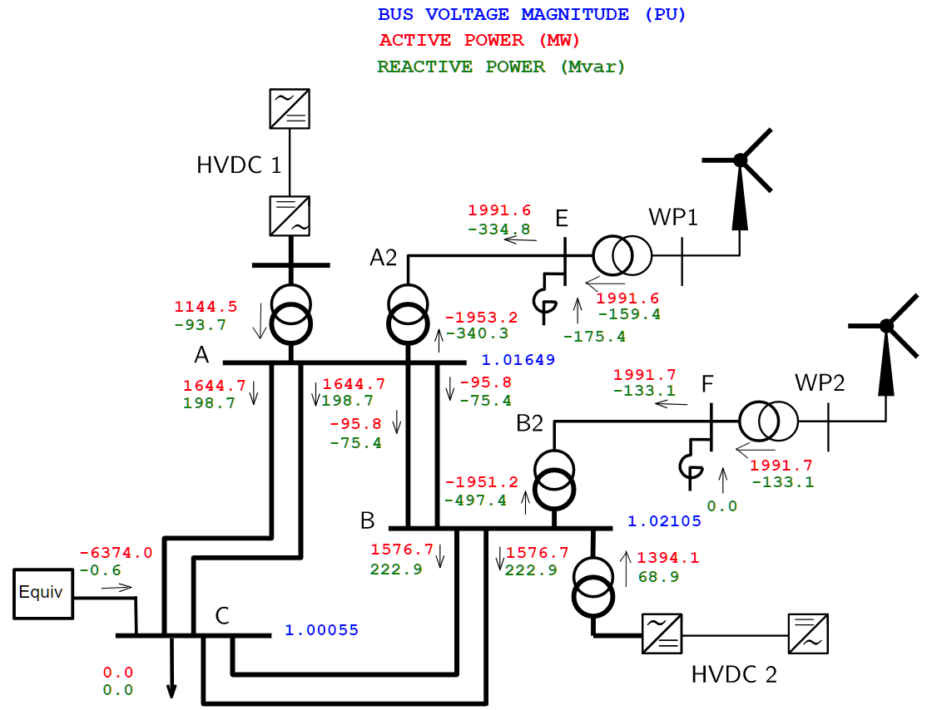
Example: large-disturbance in the 4-VSC system
Operating point No. 1
All VSCs in grid-following mode
WP1 in reactive power control
WP2, HVDC1 and HVDC2 in voltage control
short-circuit power of external system : 20 000 MVA
disturbance :
solid fault on line A-C#1, next to bus A
cleared in 150 ms by opening line A-C#1

Slide 17
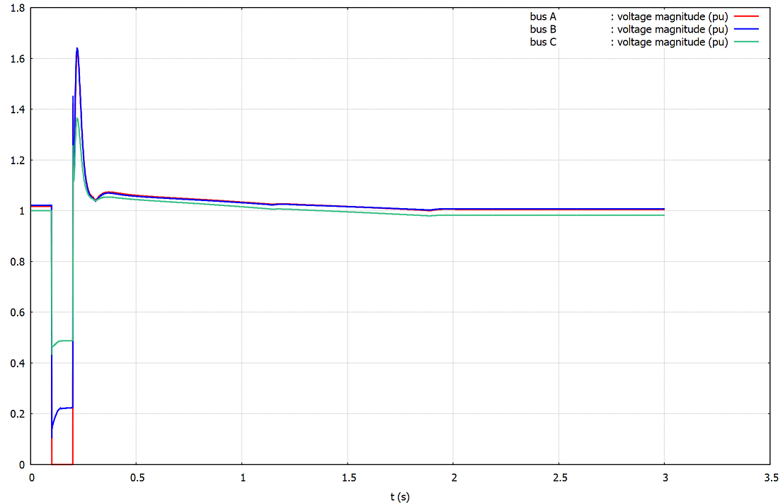
Example: large-disturbance in the 4-VSC system
Network voltages

Slide 18
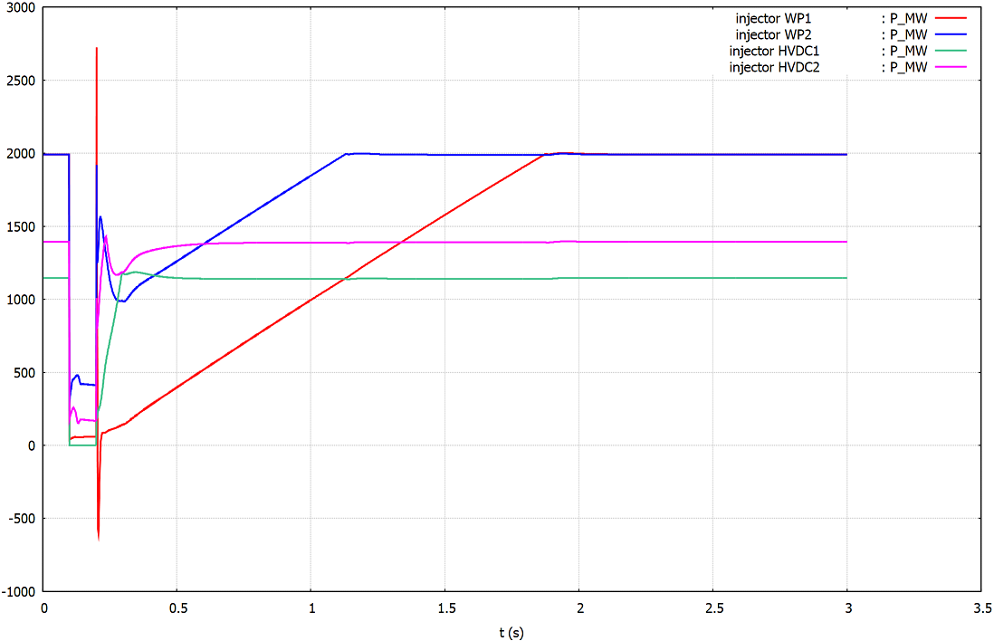
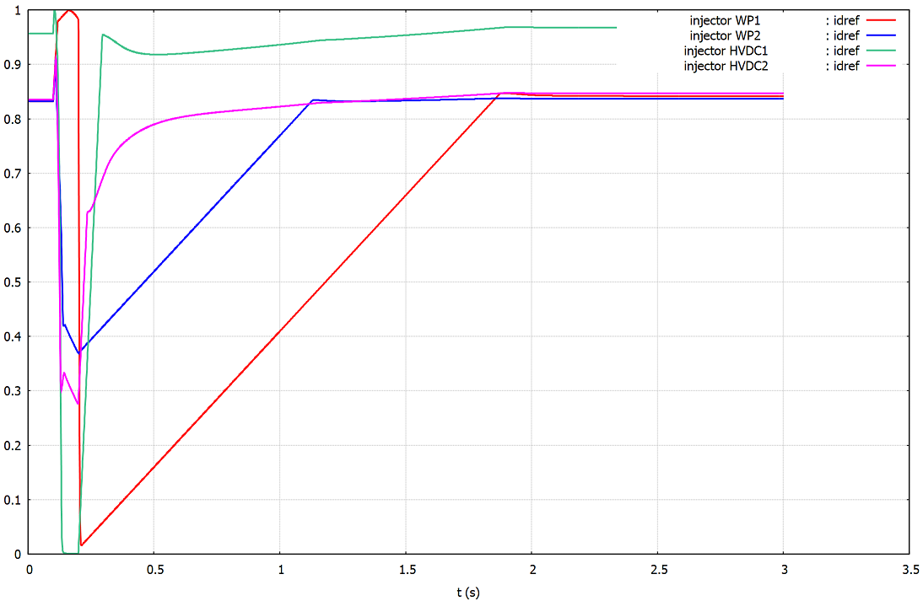
Example: large-disturbance in the 4-VSC system
Active powers $P$ and direct-current references $i_{d}^{ref}$

Slide 19
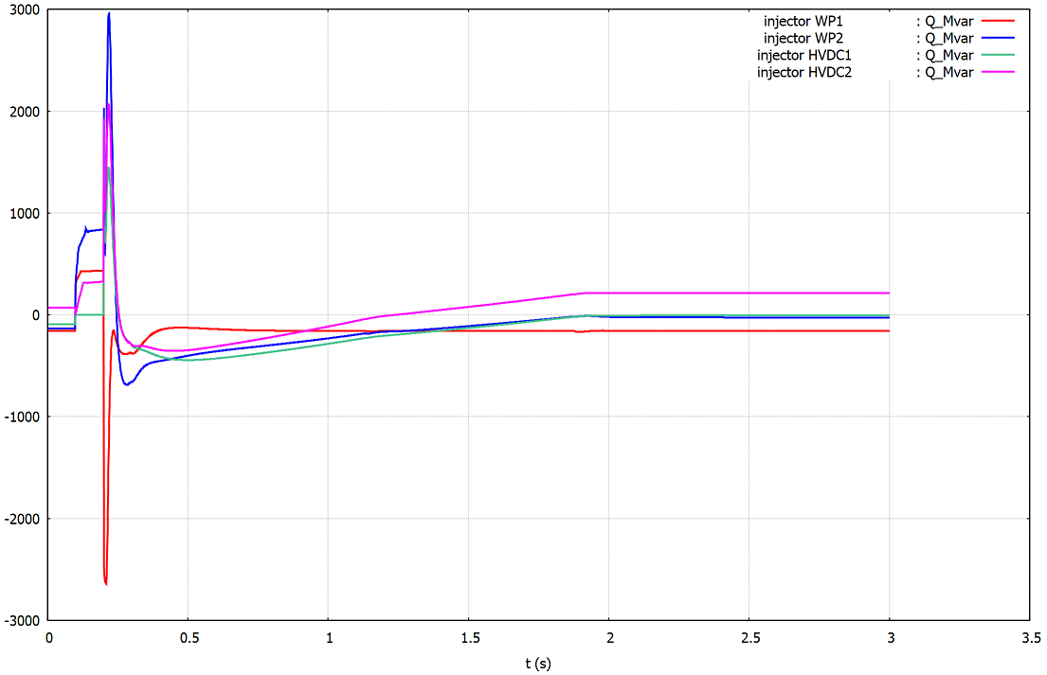
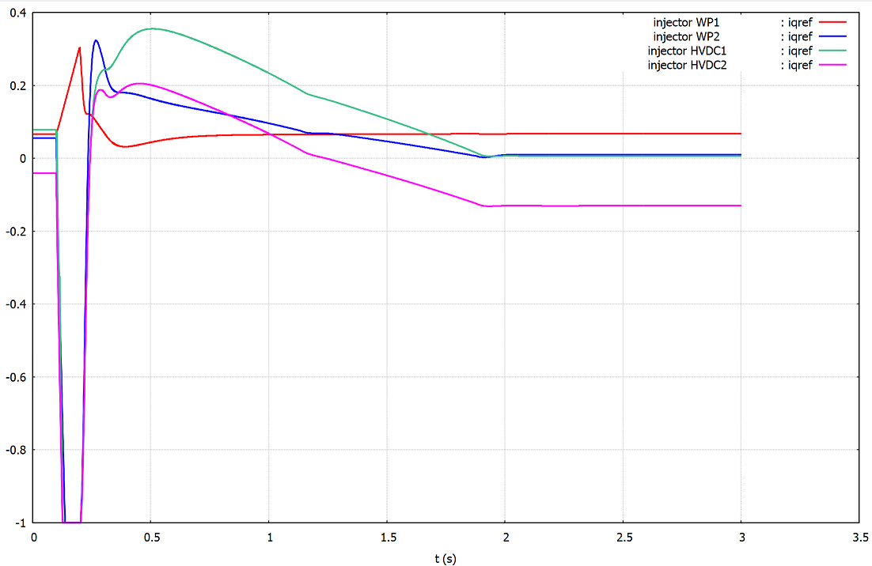
Example: large-disturbance in the 4-VSC system
Reactive powers $Q$ and quadrature-current references $i_{q}^{ref}$

Slide 20
Table of contents
Motivation and objectives
Modelling of the grid-following VSC
Examples of simulations
Comparison with EMT simulations

Slide 21
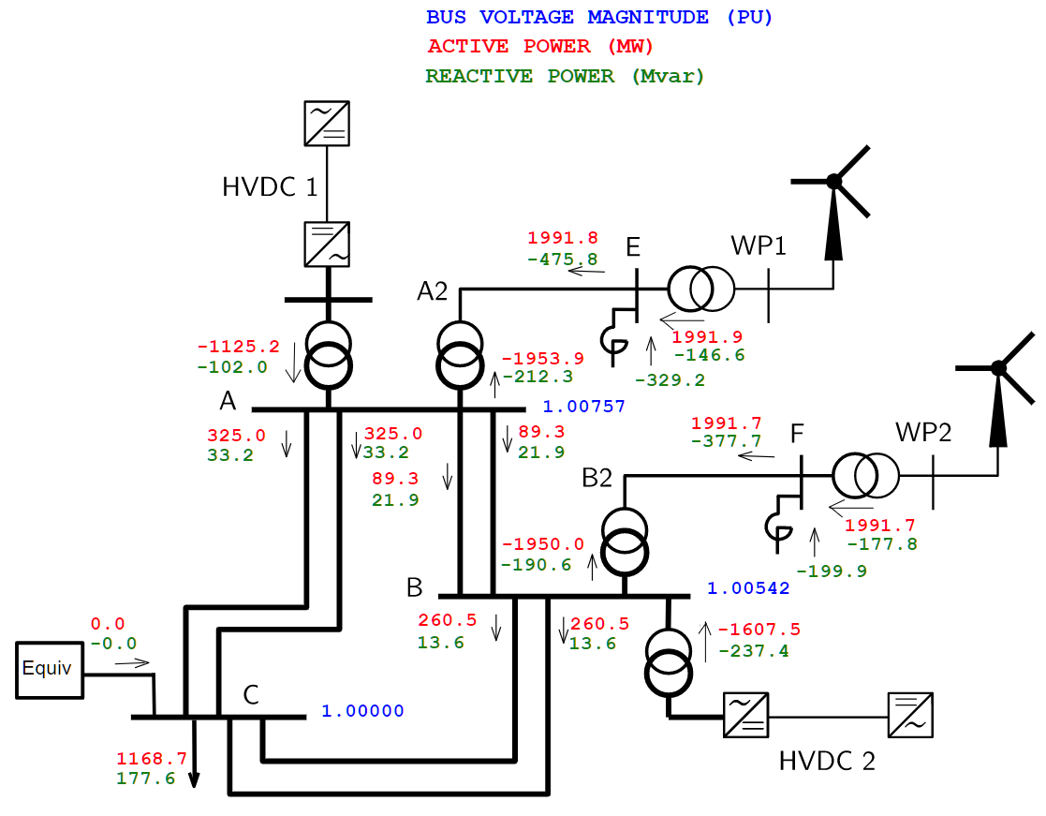
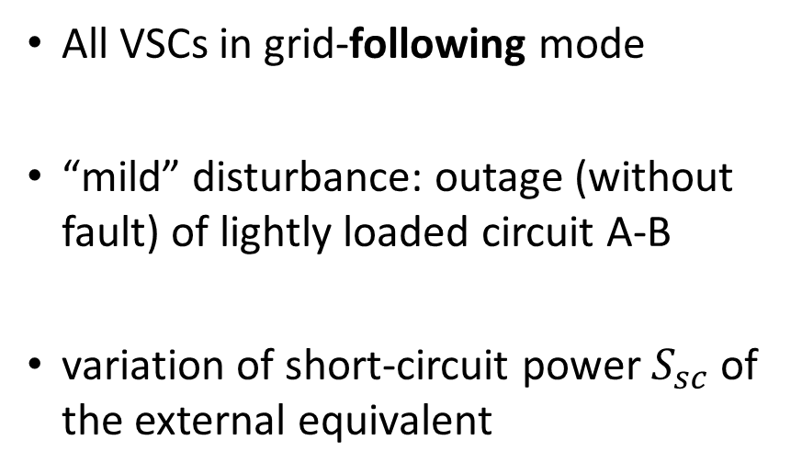
Simulation of a mild disturbance at operating point No. 2
All VSCs in grid-following mode
“mild” disturbance: outage (without fault) of lightly loaded circuit A-B
variation of short-circuit power $S_{sc}$ of the external equivalent

Slide 22
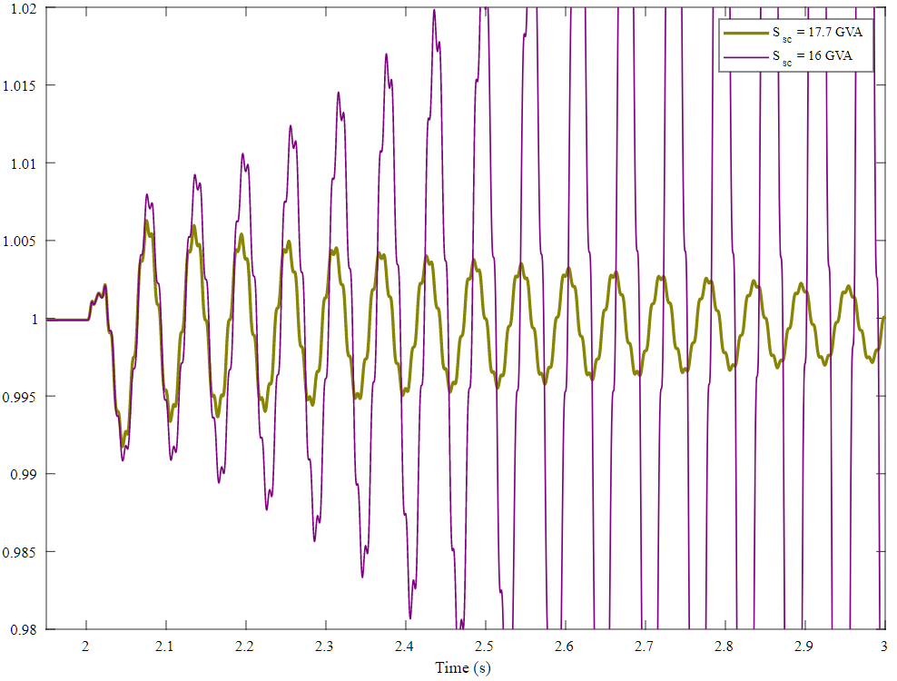
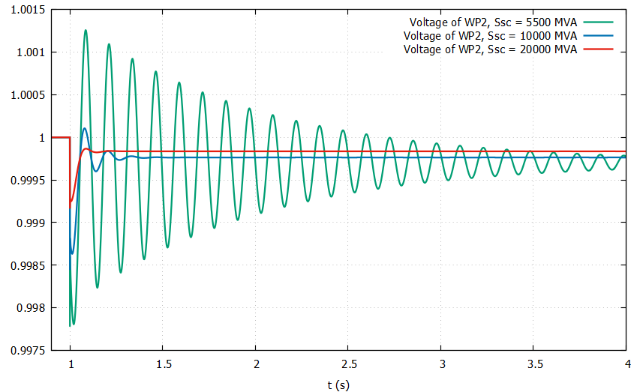

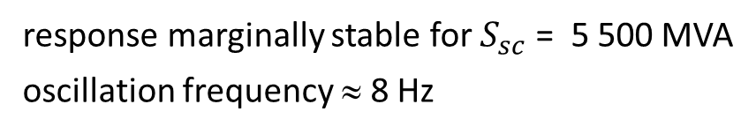
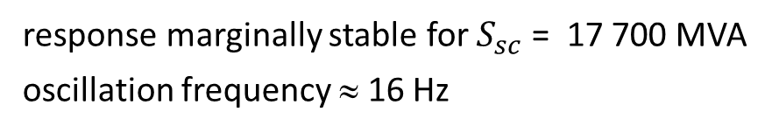
EMT vs. phasor-mode simulations
EMT model
Voltage of WP2 (pu)
Phasor approximation
response marginally stable for $S_{sc}$ = 17 700 MVA
oscillation frequency ≈ 16 Hz
response marginally stable for $S_{sc}$ = 5 500 MVA
oscillation frequency ≈ 8 Hz

Slide 23

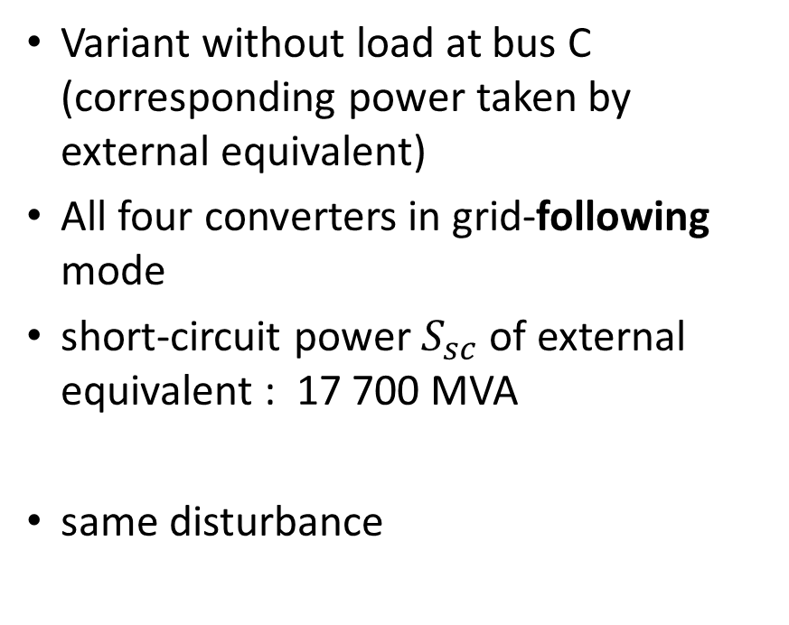
Simulation of a mild disturbance at (variant of) oper. pt No. 2
Variant without load at bus C (corresponding power taken by external equivalent)
All four converters in grid-following mode
short-circuit power $S_{sc}$ of external equivalent : 17 700 MVA
same disturbance

Slide 24
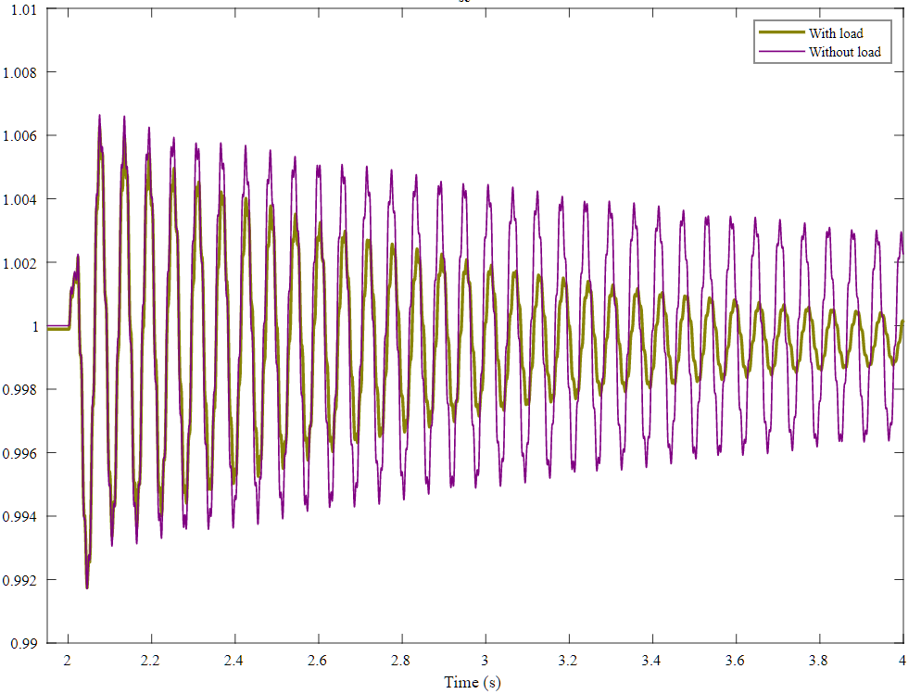
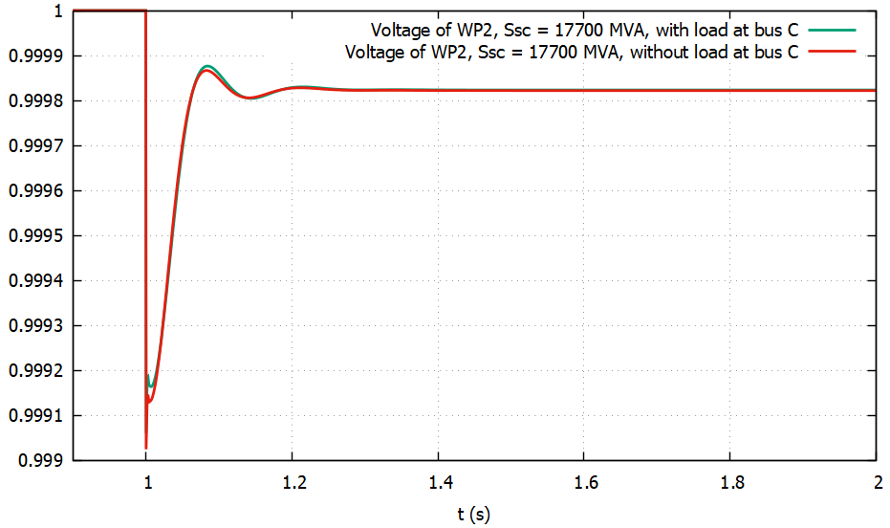
EMT vs. phasor-mode simulations
EMT model
Voltage of WP2 (pu)
Phasor approximation
Damping effect of (constant admittance) load not seen in phasor-mode simulation

